Slide 1

Skill Vault
Student Portfolio Management System
Minor Project | 21CSC206P – Advanced Object Oriented Programming
Abhishek Negi
RA2511056030023
Ajay Raj Chauhan
RA2511056030021
Sarthak Nauriyal
RA2511056030007
Guide: Ms. Neha, Assistant Professor, Dept. of CSE · SRM IST, Delhi-NCR Campus · November 2026

Slide 2
Introduction
Students build skills through coursework, projects and certifications, but the records end up scattered across notebooks, drives and platforms. Skill Vault is a Java desktop application that keeps everything in one place and turns it into a ready portfolio.
Register & Login
Secure student access
Skills
With proficiency levels
Projects & Certificates
Links, issuer, dates
My Portfolio
One consolidated view

Slide 3
Existing Problems
Information is fragmented, so no single, consistent profile exists.
Regular updates are easy to forget and hard to track across tools.
1
2
Every internship or placement needs achievements gathered manually.
Certificates, project links and skill levels are not tied to one student record.
3
4
Gap: no simple, unified desktop tool to organise these records.

Slide 4
Requirement Analysis
Functional Requirements
Software Requirements
Student registration and login
Add, update, delete skills
Add, update, delete projects
Record and view certificates
Consolidated student portfolio
MySQL storage linked by student_id
Component | Requirement
Language | Java (JDK)
GUI library | Java Swing
Database | MySQL Server
Connectivity | JDBC, MySQL Connector/J
IDE | Visual Studio Code
Hardware: Intel Core i3 or equivalent, 4 GB RAM or more

Slide 5
Architecture & Design
Java Swing User Interface
Login · Registration · Dashboard · Skills · Projects · Certificates · Portfolio
OOP Concepts Applied
Encapsulation
Model classes hold entity data
▼ calls DAO methods using Model objects
DAO Layer
StudentDAO · SkillDAO · ProjectDAO · CertificateDAO
Abstraction
UI never writes SQL directly
▼ JDBC / SQL through DBConnection
MySQL Database: skill_vault
students · skills · projects · certificates
Modularity
Each module has its own DAO and screen

Slide 6
Database Schema
ON DELETE CASCADE on all foreign keys
students (parent)
student_id (PK), name, email, password_hash, college, branch, semester
skills
projects
certificates
skill_id (PK)
student_id (FK)
skill_name
proficiency
project_id (PK)
student_id (FK)
title, description
technologies
github_url
certificate_id (PK)
student_id (FK)
title, issuer
completion_date
certificate_url

Slide 7
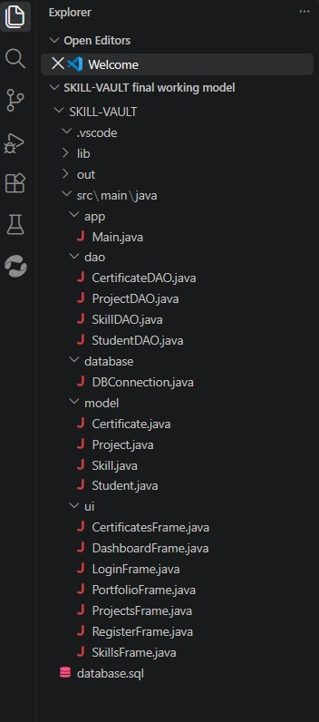
Implementation
Package | Responsibility
app.Main | Entry point; launches login
ui.* | Swing screens for all modules
model.* | Student, Skill, Project, Certificate
dao.* | Database operations per module
database.DBConnection | JDBC connection to skill_vault
All DAO classes use parameterised PreparedStatement queries.
Validation: required fields and semester range 1–12.
Project structure

Slide 8
SYSTEM WORKFLOW
01
STUDENT REGISTRATION
The student registers with personal and academic details.
02
SECURE LOGIN
The student logs in using the registered email and password.
03
DASHBOARD ACCESS
The dashboard opens and provides navigation to the application modules.
04
DATABASE OPERATIONS
The selected module uses its DAO class to insert, retrieve, update or delete records in MySQL.
05
PORTFOLIO VIEW
The portfolio view retrieves the saved profile data and displays the student’s skills, certificates and projects.
9

Slide 9
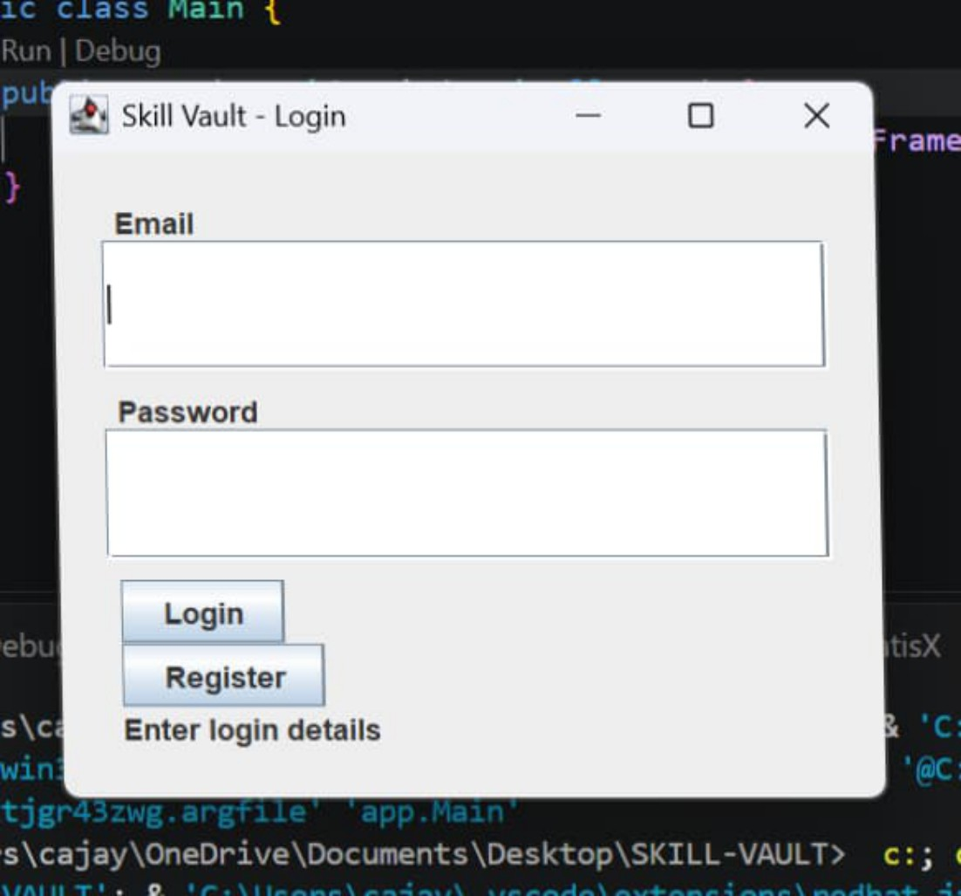
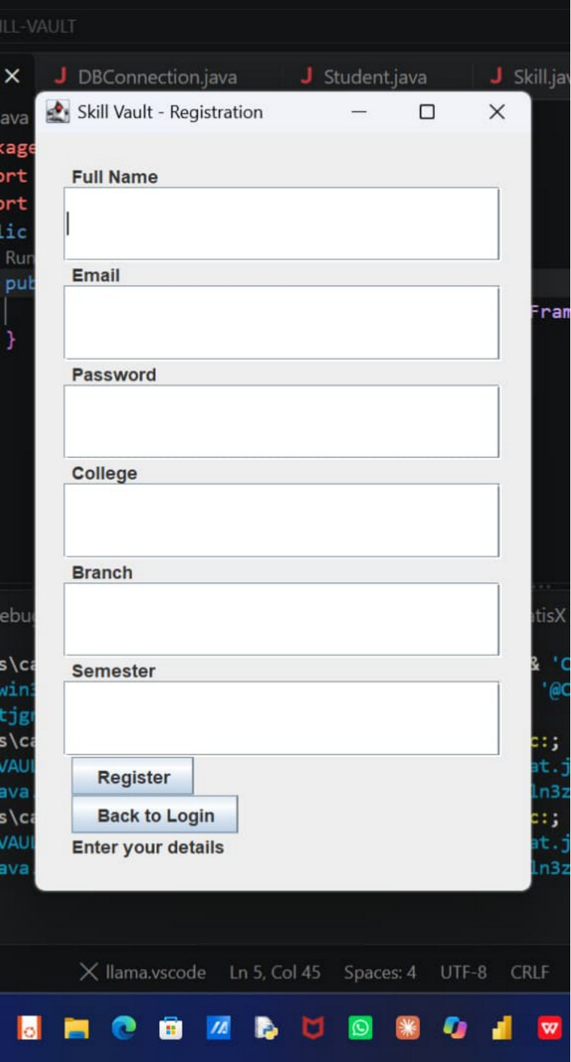
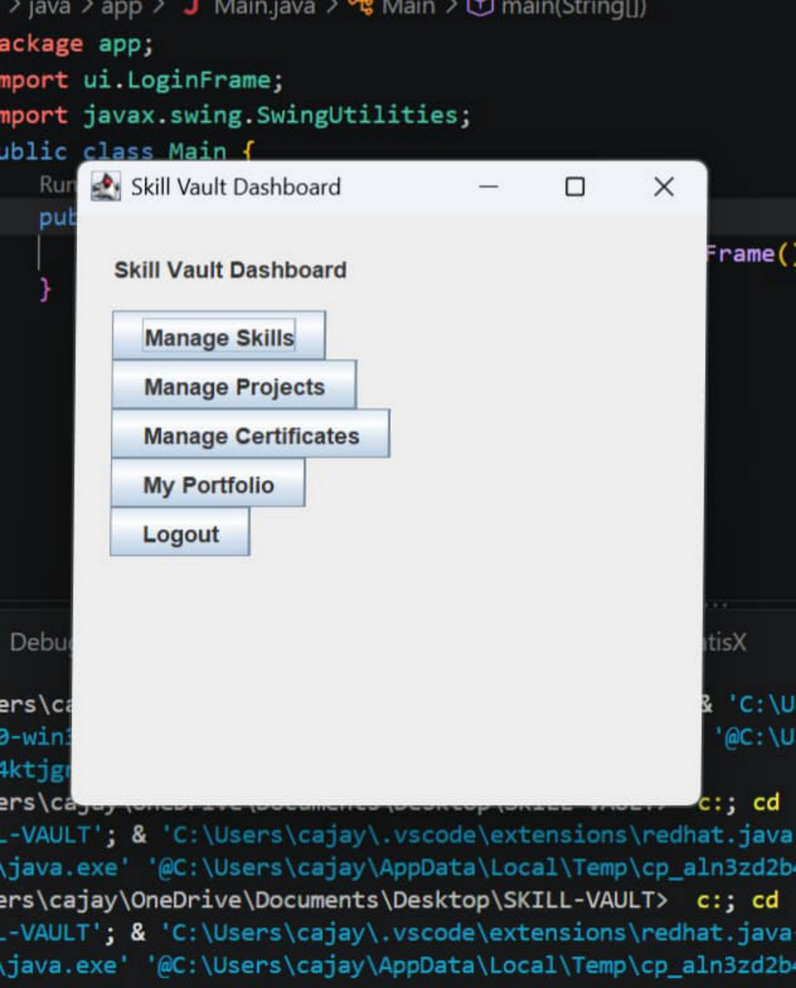
Results: Login to Dashboard
Login screen
Registration screen
Main dashboard

Slide 10
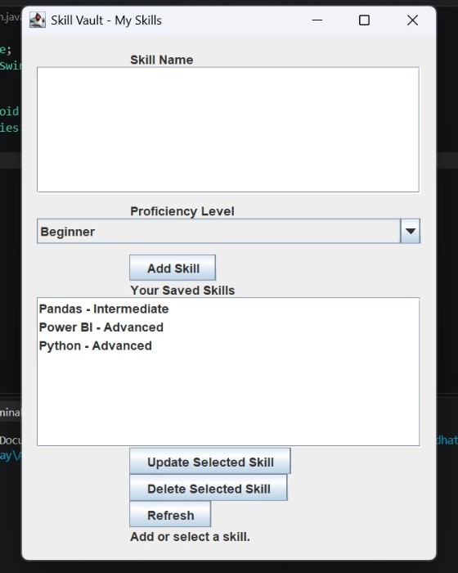
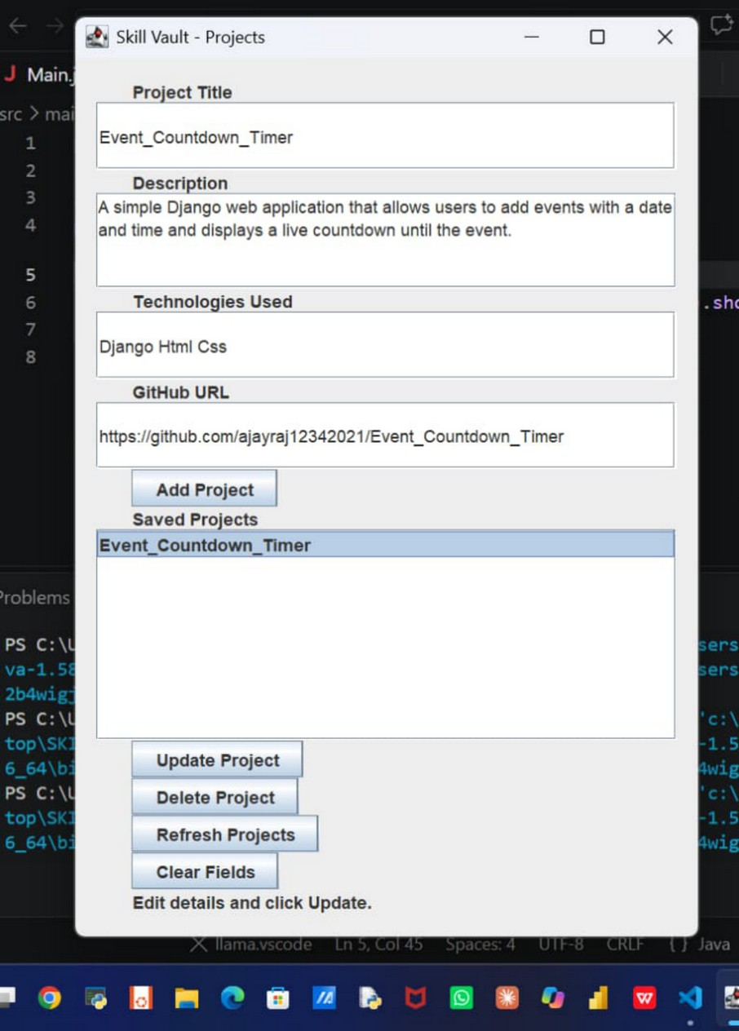
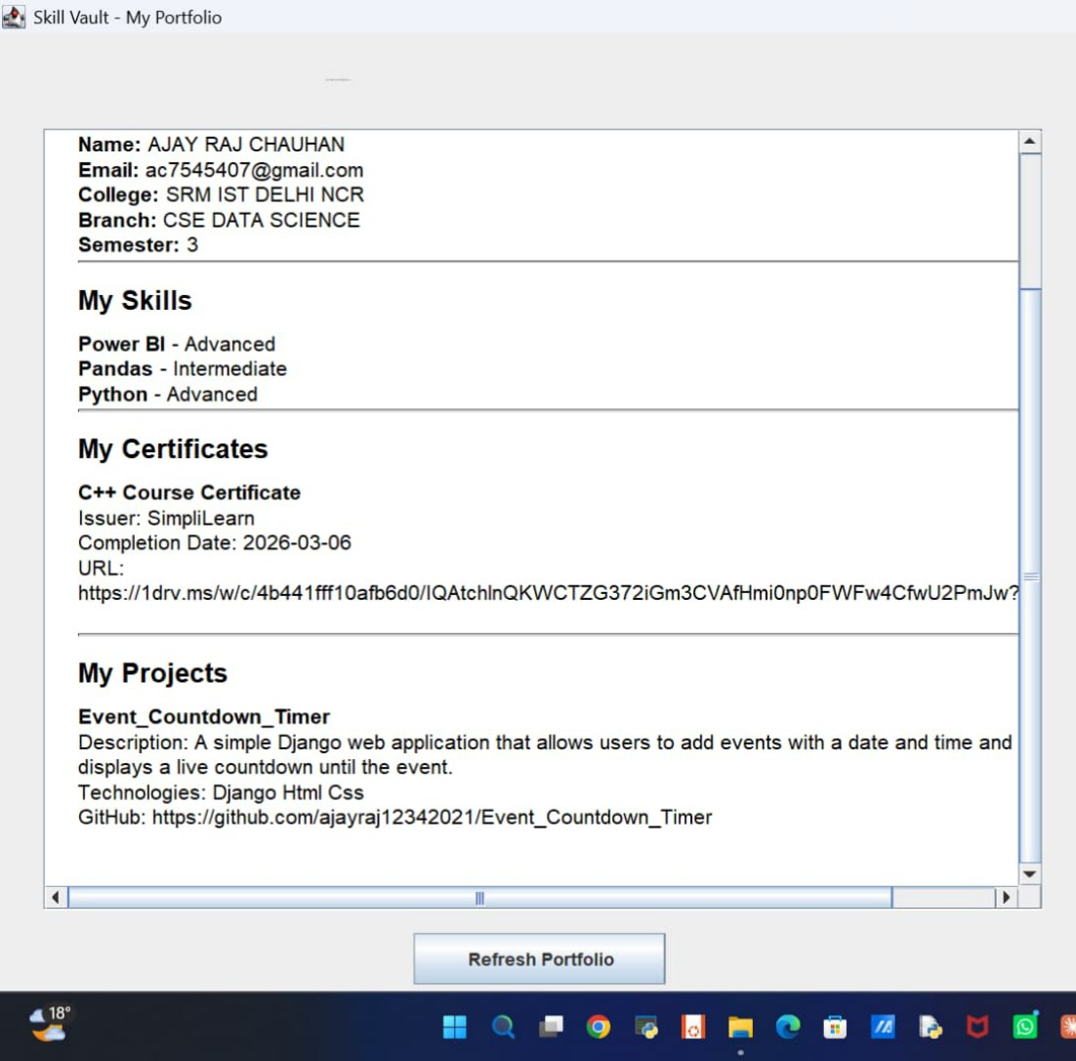
Results: Skills, Projects & Portfolio
Skills management
Project saved for update
Student portfolio

Slide 11
Testing & Known Limitations
Limitation | Planned fix
Database credentials may be hard-coded | Environment-based config, least-privilege DB users
Password storage and verification need hardening | Salted, adaptive password hashing
Limited input validation (email, date, URL, duplicates) | Format checks, clearer confirmation dialogs
Certificates can be viewed but not updated | Add update option like skills and projects
Several test cases not yet verified | Run TC-01, TC-03, TC-05 on live database
8
test cases (TC-01 to TC-08)
Registration, login, skills, projects, certificates and portfolio, backed by working screenshots.

Slide 12
Conclusion & Future Scope
Conclusion
Future Scope
Skill Vault centralises a student's skills, projects and certificates in one desktop application, and presents them as a consolidated portfolio. It applies object-oriented design, Java Swing, JDBC and MySQL in a layered, maintainable structure.
1
Password hashing, secure credentials
2
Email and date validation
3
Export portfolio to PDF, share read-only link
4
Search and filtering
5
Role-based access, database backups

Slide 13
Thank You
Abhishek Negi · Ajay Raj Chauhan · Sarthak Nauriyal
References
Oracle. The Java Tutorials – docs.oracle.com/javase/tutorial
Oracle. Creating a GUI with Swing – docs.oracle.com/javase/tutorial/uiswing
Oracle. JDBC Basics – docs.oracle.com/javase/tutorial/jdbc
MySQL Reference Manual and Connector/J Guide – dev.mysql.com/doc

